Slide 1
SME-90 E Form Training
Jay Cunningham, Division of Mine Reclamation and Enforcement
Jim Neal, Office of Administrative Services
300 Sower Blvd.
Frankfort, KY 40601

Slide 2
SME-90 E Form Differences
Access Form
E FORM
Pros:
Provided a consistent format for industry and the Cabinet
Provided monitoring data direct from the Cabinet Surface Mining Information System (SMIS).
Cons:
Importing data into the Access form was cumbersome
Didn’t always import data from Access form to SMIS.
Provided monitoring data direct from the Cabinet Surface Mining Information System (SMIS).
Had a lot of issues submitting to the Cabinet.
Pros:
Provides a consistent format for Industry and the Cabinet to report quarterly water monitoring data.
Import of data into the E form is much easier due to text script rather than numerical values.
Directly communicates from SMIS.
Do not have to rely Desktop Configurations.
No more FTP site and easier for both the Cabinet and Industry to validate submittals.
Cons:
Directly communicates with SMIS.
Can not use Internet Explorer. All other Browsers will work, except for Internet Explorer.
E Form is not made for printing and can be cumbersome to print.

Slide 3
How does the SME-90 E Form Work?
Kentucky Online Gateway:
Kentucky Online Gateway is the gateway all EEC E Form applications.
Goal is to grow and obtain all EEC forms on the E Form platform.
https://kog.chfs.ky.gov/home/
Why?
E Forms and Kentucky One Stop provide more security
Web Based
Not a software you have to download like the old Access version of the SME-90.

Slide 4
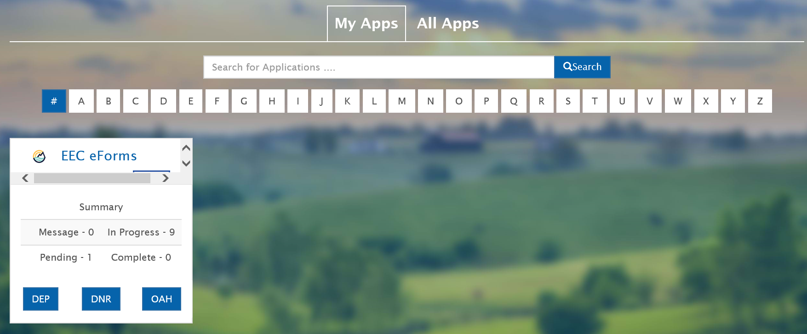
Kentucky Online Gateway
Must register and obtain username and password. You can not change the username, so please ensure log-in information is retained in your records. You can reset the password and retrieve your log-in identification if you forget it.
Once you log in, the screen should look something like this:

Slide 5
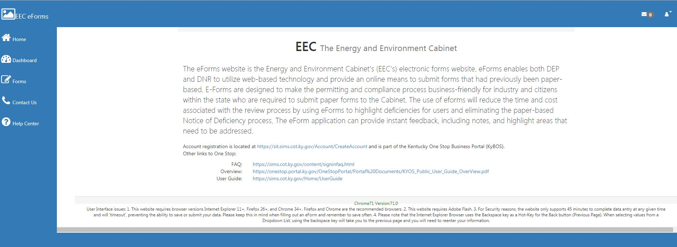
Kentucky Online Gateway Cont’d
Simply click on DNR tab and it should direct you to the page below:

Slide 6
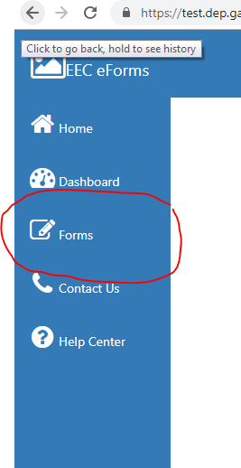
Kentucky Online Gateway Cont’d
After you have completed your username and password, simply log in and click on the form tab:
Once you open the form tab, you can search based upon the form name; Division Name, or Department (DNR or DEP).
Once you find the SME-90, simply open by clicking the blue cross on the “add form” column.

Slide 7
Implementation
The SME-90 E Form is available now at: https://dep.gateway.ky.gov/eForms/Account/Home.aspx
The third (3rd)of 2019 is optional for E Form usage, but highly recommended.
Fourth (4th)quarter data submittal of 2019, the E Form is required and Regional Offices will no longer accept any other form.

Slide 8
Questions?
In the event that you have form issues, please click on the Help Center, where DNR and DEP have sections on; Frequently Asked Questions; How to Create an account for E Forms; and updated to any changes in the E Form.
The SME-90 E Form does not require any download of a program. If you have working internet you can operate and maneuver the SME-90 form.
Issues:
Programmatic Issues: Contact Jay Cunningham, with the Division of Mine Reclamation and Enforcement
In the event that the website does not work, contact Jim Neal or Mike Nielsen.
Monitoring Point issues, contact Thomas Barbour with the Division of Mine Permits.

Slide 9
Contact Information
Jay Cunningham, Division of Mine Reclamation and Enforcement
Email: Jay.Cunningham@ky.gov
Telephone: 502-782-6591
Division of Mine Permits:
Thomas Barbour, Division of Mine Permits
Email: Thomas.Barbour@ky.gov
Telephone: 502-782-6549
Website not working contact Jim Neal or Mike Nielsen, Office of Administrative Services
Jim Neal
Email: Jim.Neal@ky.gov
Telephone 502-782-6424
Mike Nielsen
Email: Michael.Nielsen@ky.gov
Telephone: 502-782-6427

